Slide 1
Independent Study Progress Report Fall 2019
By: Ruairidh Barlow
Mentors: Dr. Chen and Dr. Smirnova

Slide 2
Project Goals
Use data collected from a Sensor Dot to visualize a subject’s heart rate and breathing rate over the same period of time
Understand the working principles behind ECGs and accelerometers
Learn how to process collected data from both ECGs and accelerometers using MATLAB
Learn how to program in MATLAB

Slide 3
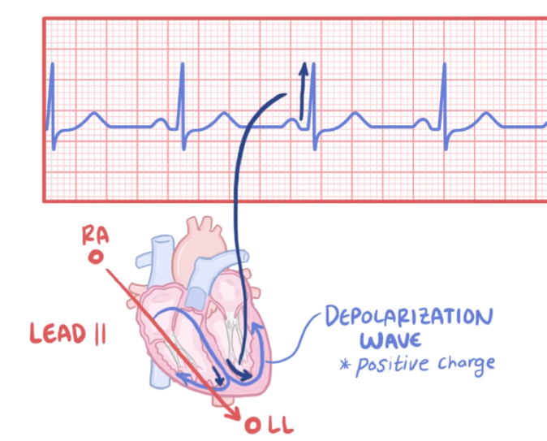
Electro - cardio – gram (ECG)
Visualizes the movement of a wave of depolarization through the heart
Depolarization = positive charge
Wave appearance depends on the set of electrodes being used
Movement of wave from right arm (ra) electrode to left leg (ll) electrode you get a positive (upward) deflection
Notes:
Electricity - Heart – visualize
This example uses that Lead 2, electrode on right arm (ra) and electrode on left leg (ll)
(upward) deflection which reflected in the spike on the graph
Explain lead and axis are terms that can be used interchangeably

Slide 4
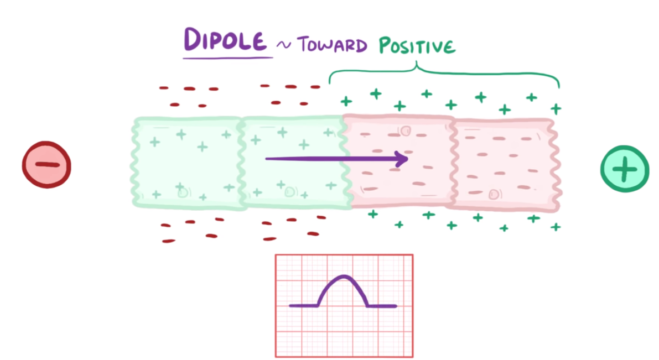
ECG working principle
Electrodes measure the charge on the outside of heart cells
Resting cells are polarized (negative)
Wave of depolarization passes through cells, they are then depolarized (positive)
Dipole is when a wave is in the middle of passing through cells
Dipole vector (arrow) points towards the positive charge
ECG tracing shows this as a positive (upward) deflection
Notes:
Positive and negative electrodes
The bigger the dipole the bigger the deflection

Slide 5
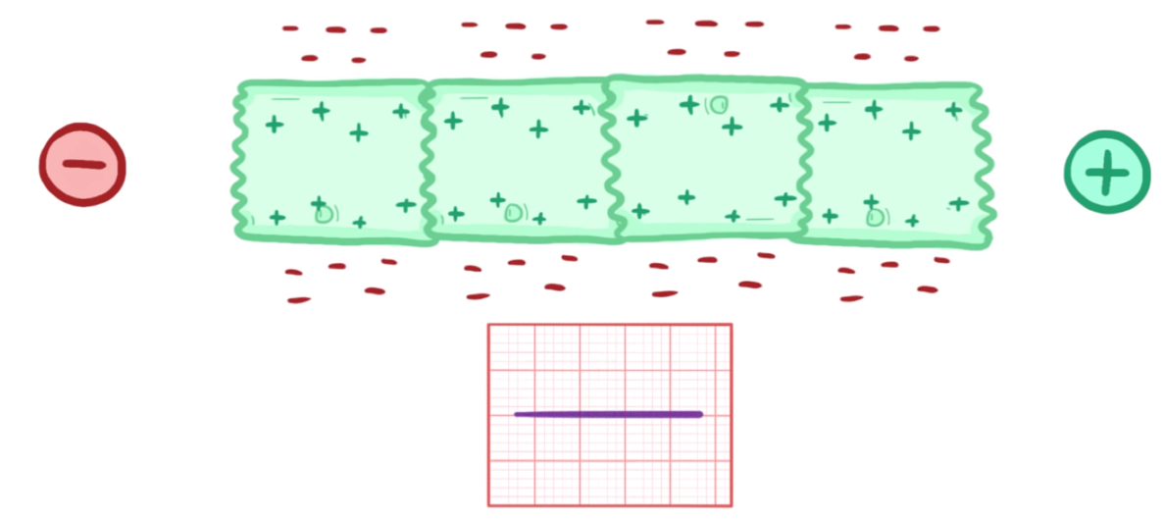
ECG working principle
There is no dipole when wave of depolarization moves completely through the cells
Results in a flat line, no deflection
Notes:
Positive and negative electrodes
The bigger the dipole the bigger the deflection

Slide 6
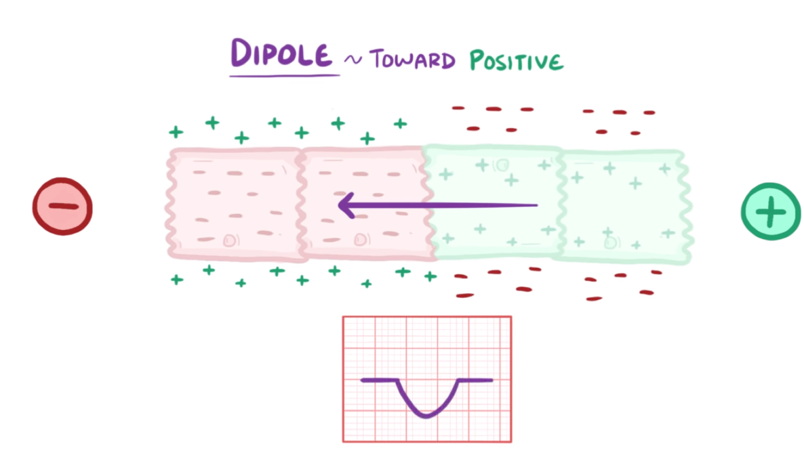
ECG working principle
Wave of repolarization (negative)
Dipole vector (arrow) points towards the negative charge
ECG tracing shows this as a negative (downward) deflection
Notes:
When the wave isn't moving directly towards an electrode
Break the dipole vector into the horizontal and vertical components
We care about the one that is moving towards the electrode
Since the vectors are smaller, they will have a smaller deflection recorded

Slide 7
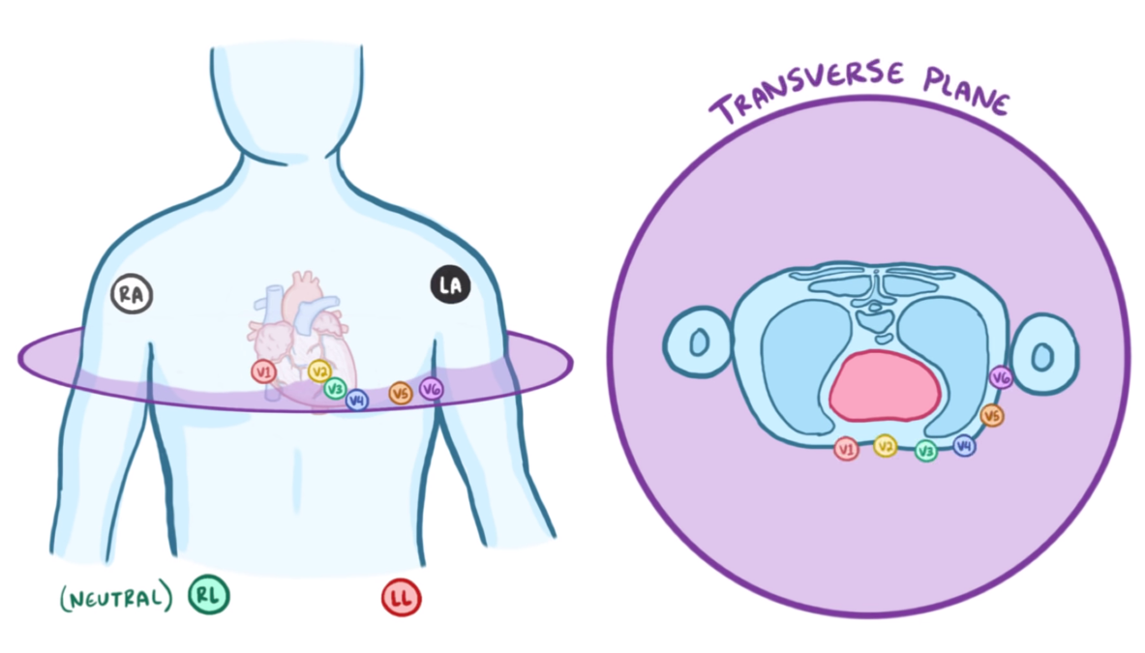
ECG working principle
There are a total of 10 electrodes in a standard ECG
Notes:
4 limb electrodes RA, LA, LL, RL (right leg neutral)
6 precordial electrodes on chest (known as chest leads)
V1 - V6, line the transverse plane (horizonal) of heart
All are set up to detect any positive wave that comes towards them

Slide 8
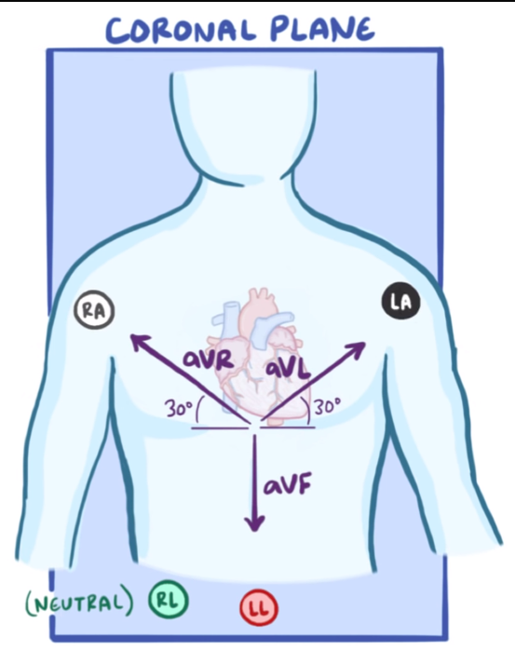
ECG working principle
4 limb electrodes: RA, LA, LL, RL (right leg neutral)
Limb leads that detect positive waves (denoted in purple)
Use one electrode
Notes:
an imaginary plane dividing the body into dorsal and ventral parts
If you were to cut a person in half between their front and back plane
AVR (augmented vector right)
AVL (augmented vector right)
Both are vectors that are 30 degrees from heart
AVF (left foot)

Slide 9
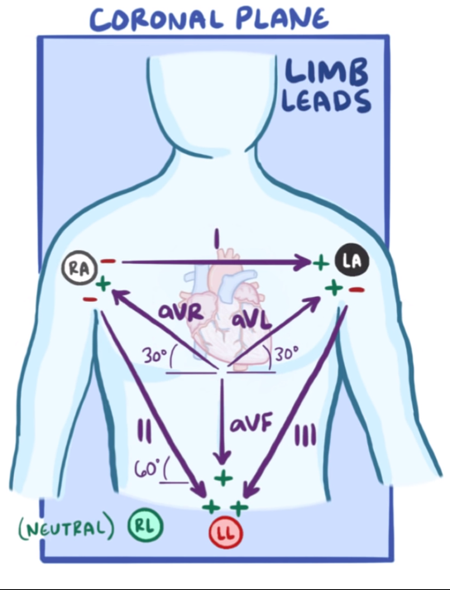
ECG working principle
Bipolar limb leads
Use 2 electrodes
I: Uses RA and LA moves from negative to positive
II: RA to LL negative to positive at 60 degrees
III: LA to LL, 120 degree angel
There are a total of 6 limb leads
Notes:
Denoted in purple as well

Slide 10
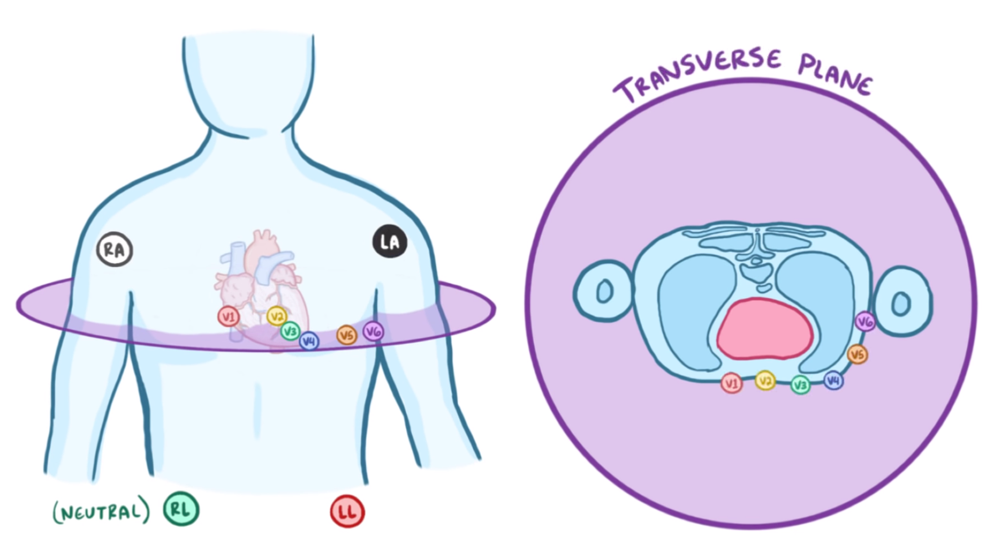
ECG working principle
6 precordial electrodes on chest (chest leads)
V1 - V6, line the transverse plane of the heart
Total of 6 leads
Notes:
Transverse (horizonal)
All detect positive waves
They are all positive electrodes

Slide 11
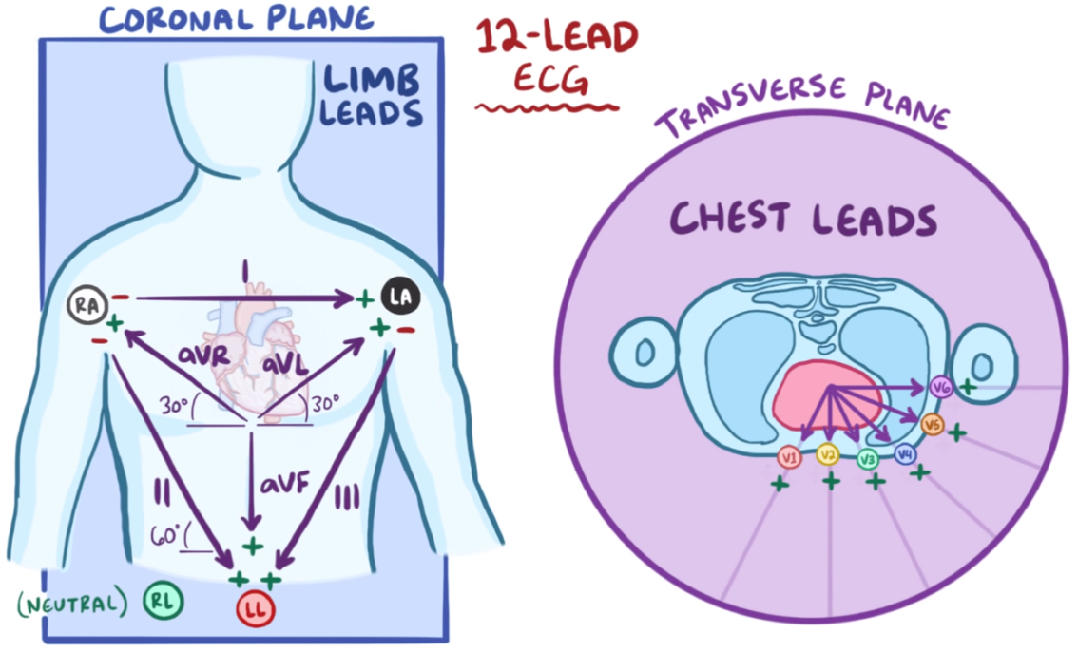
ECG working principle
10 electrodes in a standard ECG (RA, LA, RL, LL, V1 - V6)
12 leads make up the standard 12 lead ECG
Notes:
It is important to understand that there are 10 electrodes in a standard ECG (RA, LA, RL, LL, V1 - V6).
But there is a total of 12 leads being recorded

Slide 12
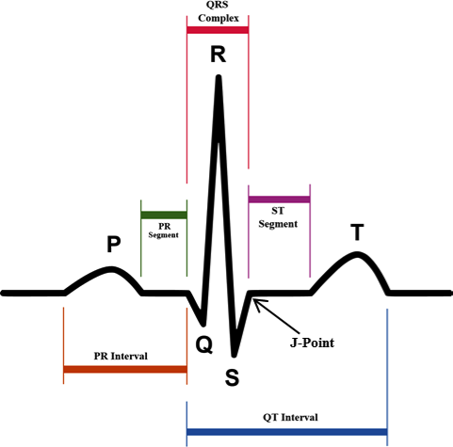
QRS Complex
The combination of three of the graphical deflections seen on a typical ECG
Usually the main spike seen on the ECG line
The QRS complex lasts 0.06 - 0.12 seconds in adults
Notes:
Relate this back to the 2 axis ecg

Slide 13
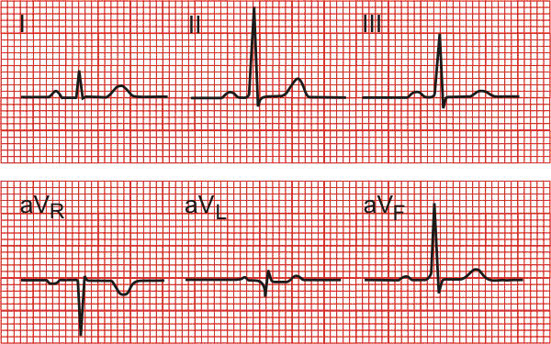
II Axis ECG Detection
QRS Complex is clearest when traced using the II axis
Clear tracing allows for accurate signal processing
Notes:
https://www.cvphysiology.com/uploads/images/ECG%20stnd%20leads.gif
Understand what each axis can represent better
If you want to understand what is the p and t wave is doing which axis do you want to look at
P wave
Should be upright (positive) in leads 1 and II
Downright in aVR
QRS complex
QRS be mostly positive (upright) in leads II and I
T wave
T wave is always upright in leads I, II, V3-6
Always inverted in lead aVR

Slide 14
II Axis ECG Detection
Notes:
https://www.cvphysiology.com/uploads/images/ECG%20stnd%20leads.gif
Understand what each axis can represent better
If you want to understand what is the p and t wave is doing which axis do you want to look at
P wave
Should be upright (positive) in leads 1 and II
Downright in aVR
QRS complex
QRS be mostly positive (upright) in leads II and I
T wave
T wave is always upright in leads I, II, V3-6
Always inverted in lead aVR

Slide 15
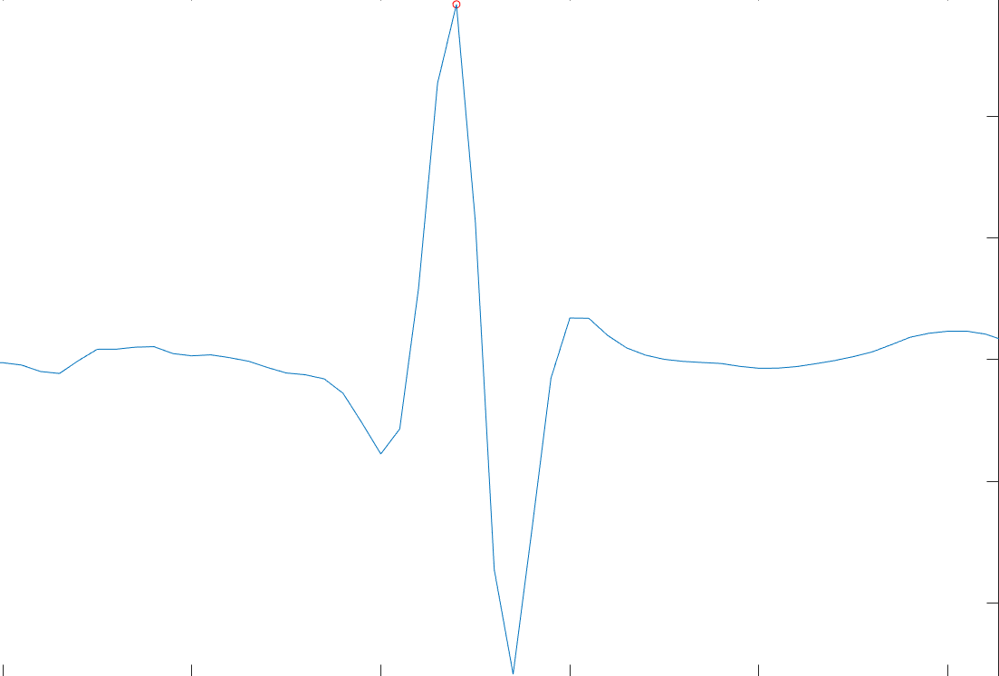
QRS Complex
Notes:
Relate this back to the 2 axis ecg

Slide 16
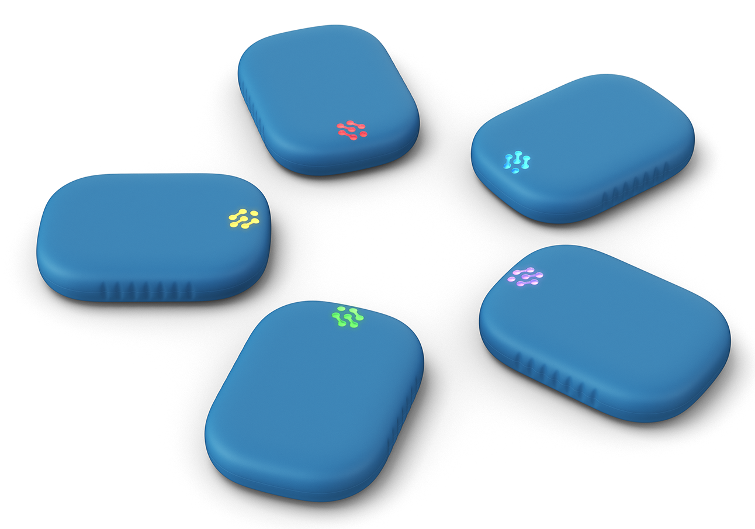
Byteflies Sensor Dot
Each sensor contains an array of sensors
II axis ECG
Triaxial Accelerometer
Can be used in tandem to collect multiple types of data at the same time
Sensors collect physiological waveforms
Notes:
https://www.byteflies.com/science
Electrocardiogram Role (ECG):
Respiration (RES):
Photoplethysmography (PPG): optically obtained plethysmogram that can be used to detect blood volume changes in the microvascular bed of tissue. A PPG is often obtained by using a pulse oximeter which illuminates the skin and measures changes in light absorption
Inertial Measurement Unit (IMU)

Slide 17
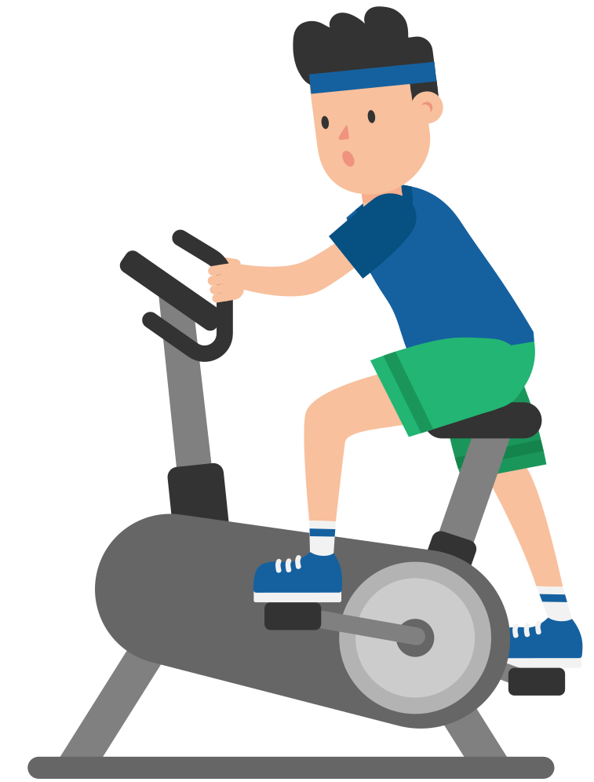
Data Collection Protocol
Adapted from Boyle et al., 2009
10 minutes resting on a bed
5 minutes sitting in a chair
5 minute exercise sessions
70 kg resistance
140 kg of resistance
180 kg resistance
Each followed by 5 minutes of rest in a chair
Notes:
https://webstockreview.net/pict/get

Slide 18
ECG Signal Processing in MATLAB
Filtering data
Removal of unwanted segments and frequencies from the signal
Feature detection, repeating patterns are selected
A feature is a recurring shape that tells us something physiologically interesting
Beats Per Minute (BPM) Calculations
Notes:
(How it is supposed to be done)
Sometimes a feature can occur at an unpredictable time, like when there is a sudden change in motion
Or they can be cyclical, like a heart beat
Example: ECG signal, a very large number of features can be extracted
R-peak, denoting ventricular depolarization; the P-wave, denoting atrial depolarization; and the T-wave, denoting ventricular repolarization

Slide 19
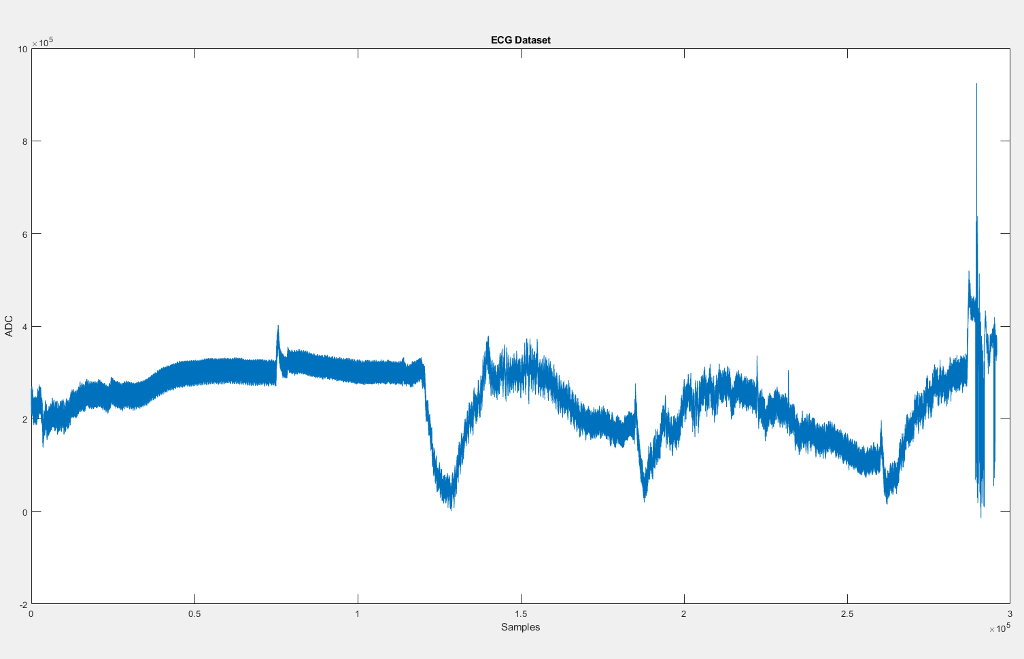
MATLAB Filtering Data: Import Signal
Notes:
Artifact from putting the sensor on

Slide 20
MATLAB Filtering Data: Import Signal
Notes:
Artifact from putting the sensor on
A data artifact is a data flaw caused by equipment, techniques or conditions.
Get x coordinate and

Slide 21
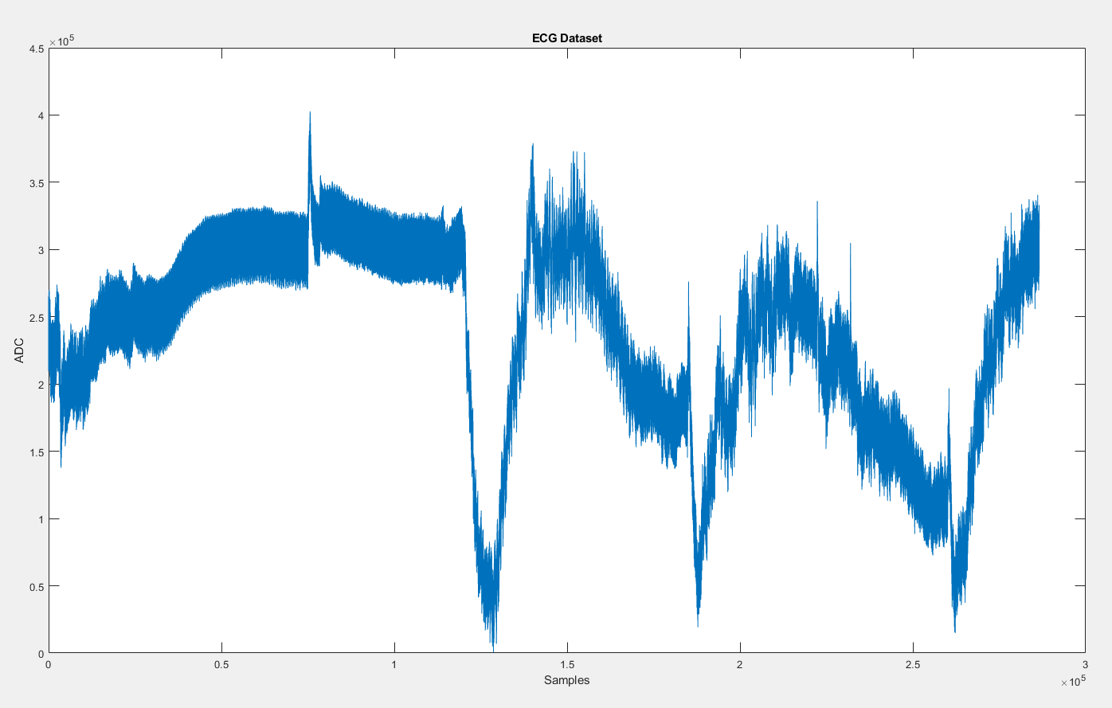
MATLAB Filtering Data: Import Signal
Notes:
Artifact from putting the sensor on

Slide 22
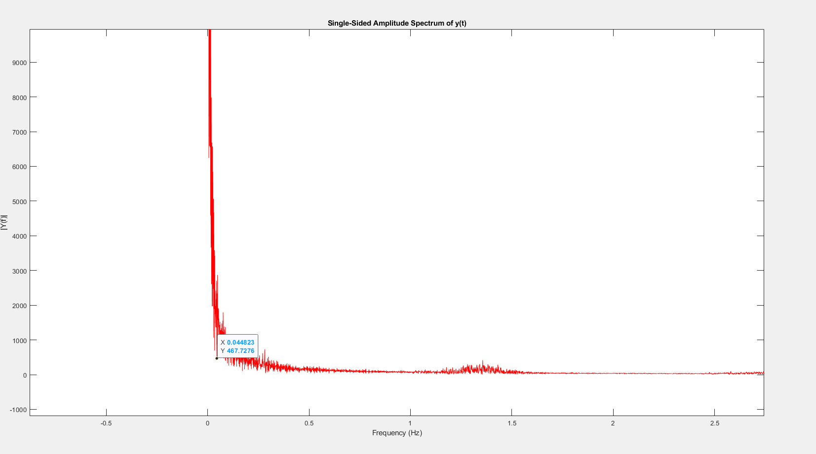
MATLAB Filtering Data: Fourier Transform
Transforming a signal in the time domain into the frequency domain
Identifies the frequency where signal drift lies
Notes:
https://www.youtube.com/watch?v=1JnayXHhjlg
Find the x coordinate
Everything past this point is what will get through the filter
This point is where the signal drift lies
Drifts are signal of low freq

Slide 23
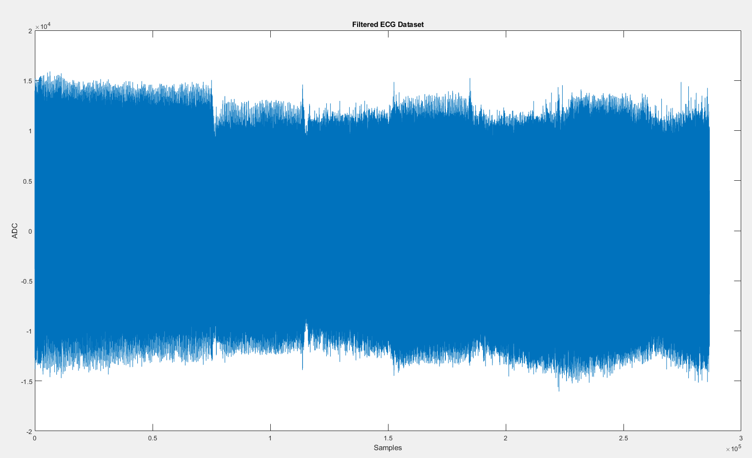
MATLAB Filtering Data: Butterworth Filter Design
Signal processing filter with a frequency response that is flat as possible
Frequency response is used for peak detection

Slide 24
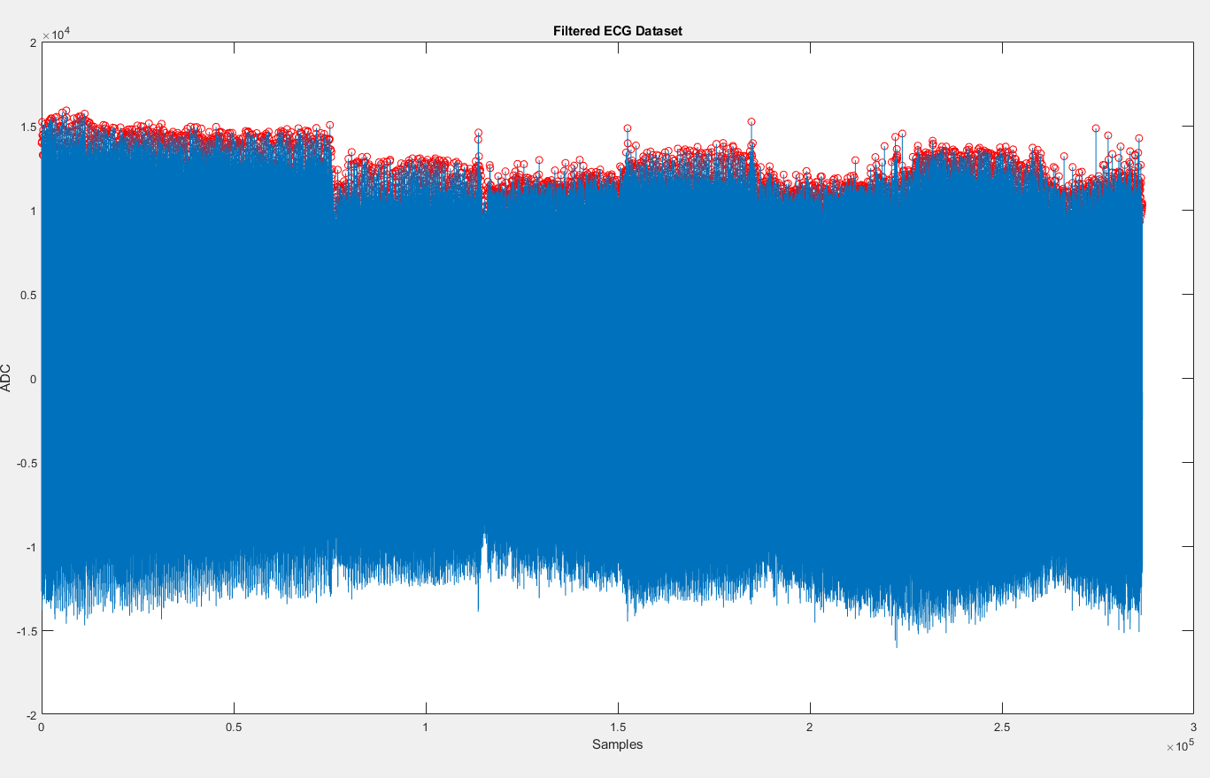
Peak Detection
findpeaks function in MATLAB
Peak height and distance parameters are set by hand

Slide 25
BPM Calculations Functions
Overall BPM for entire signal
Sliding window method
Overlapping
Non-overlapping
Peak frequency based method

Slide 26
Overall BPM Calculation
Count total number of R peaks (beats)for entire signal
Divide signal length by the frequency it was captured at to get seconds
Convert seconds to minutes
Divide number of beats by minutes
Notes:
Mention this function is used in windowed as well

Slide 27
Sliding Window BPM Calculation
MATLAB's buffer function broke up signal into windows of X length
Parameter for overlap length
Count number of R peaks (beats) in each window
Call overall BMP calculation function (from previous slide)
Use window length instead of signal length
Store the BPM of each window and calculate the average BPM

Slide 28
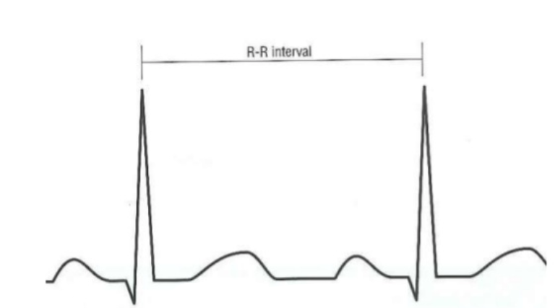
Peak Frequency BPM Calculation
Calculate the distance between peaks
Divide distances by the sampling frequency to convert to seconds
Calculate the frequency of that window between peaks
Frequency = 60 (seconds/minutes) / distance (seconds)
Notes:
https://pt.slideshare.net/cetdmgh/introduction-to-ecg-29796681

Slide 29
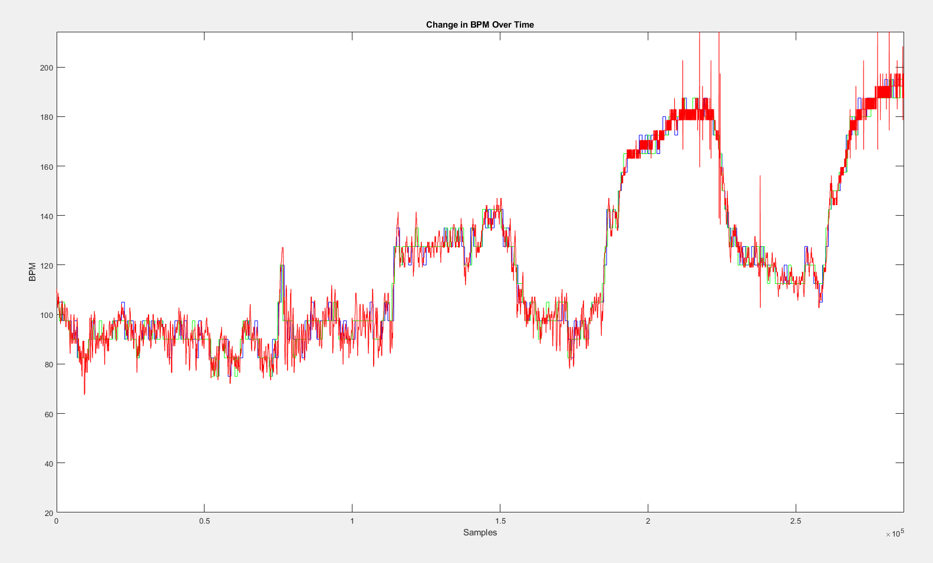

Slide 31
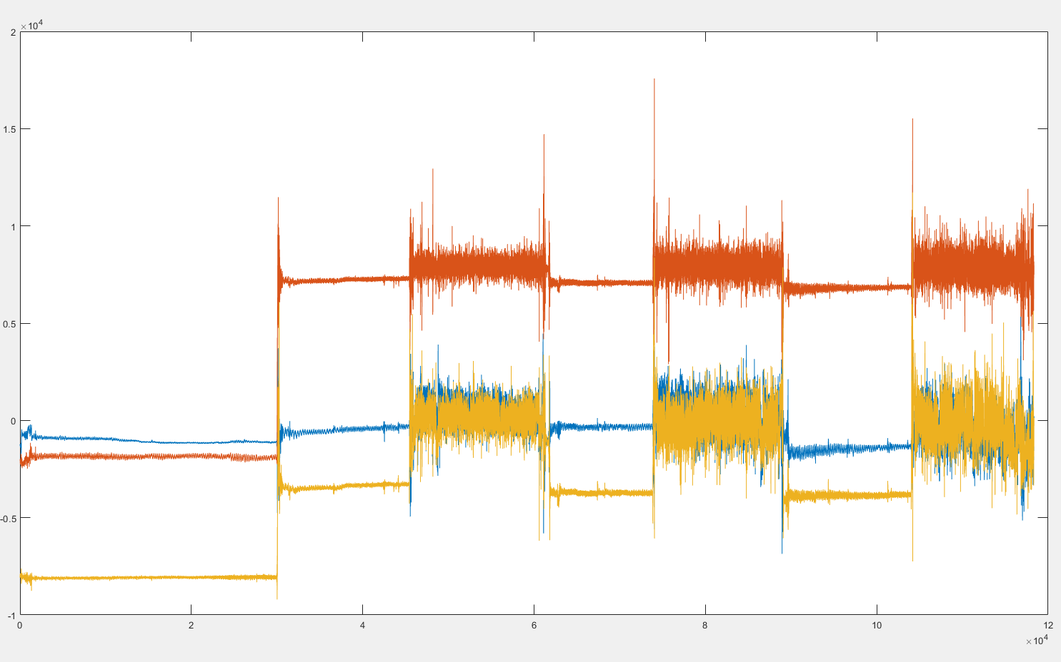
Accelerometer Data
Notes:
Y red
Z yellow

Slide 32
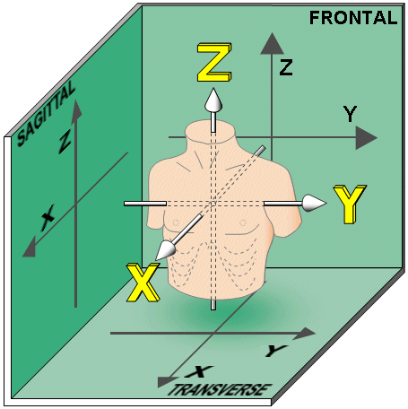
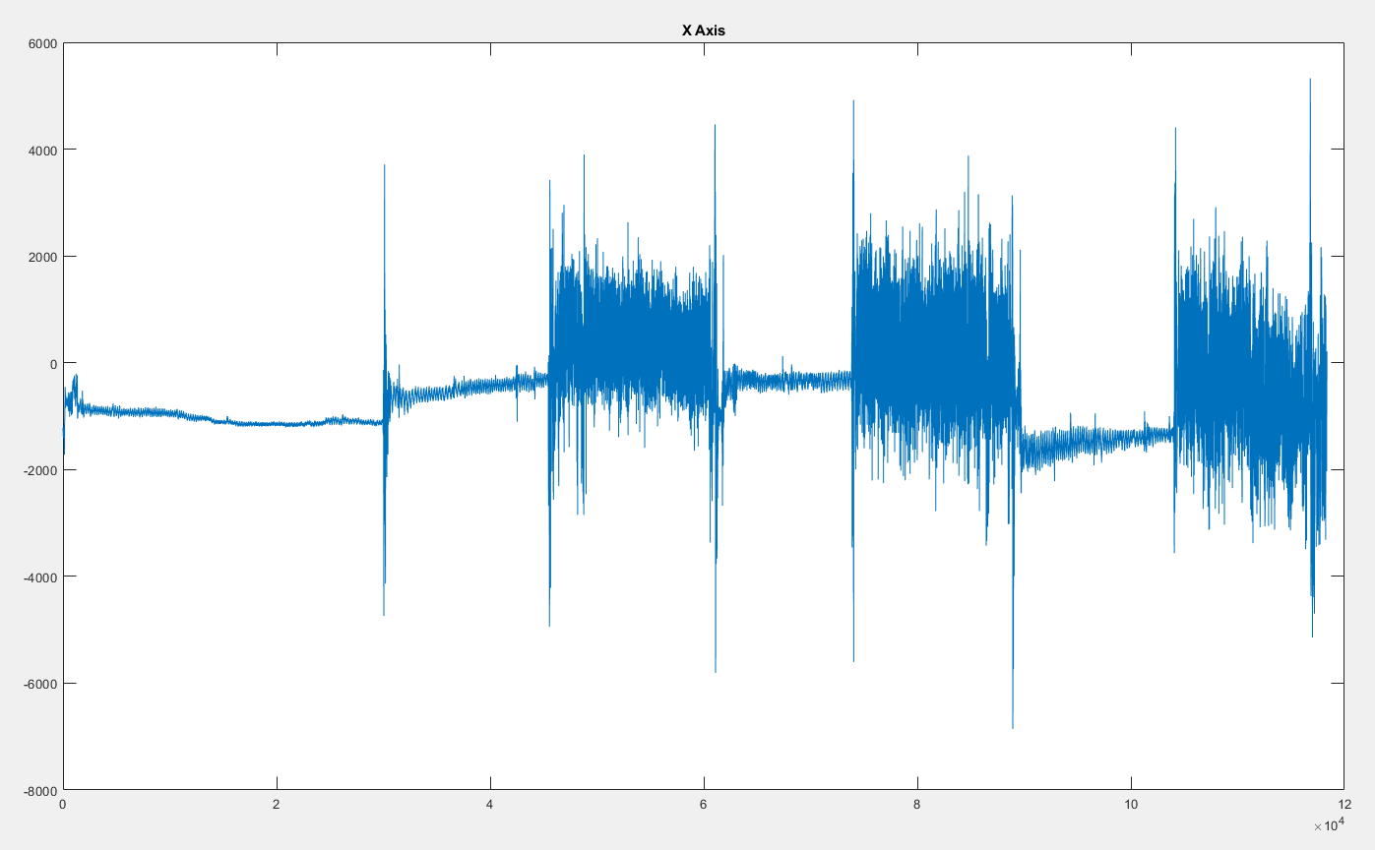
Accelerometer Data
Notes:
http://www.bem.fi/book/aa/fi/aa01.gif

Slide 33
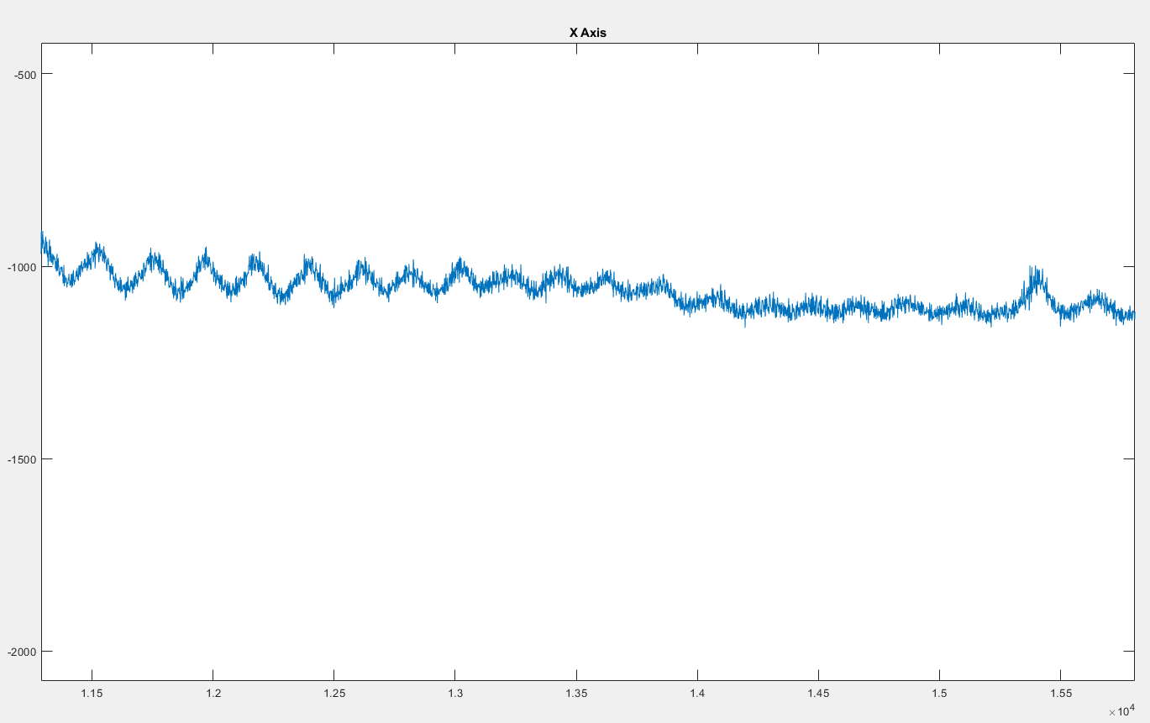
Accelerometer Data
Notes:
http://www.bem.fi/book/aa/fi/aa01.gif

Slide 34
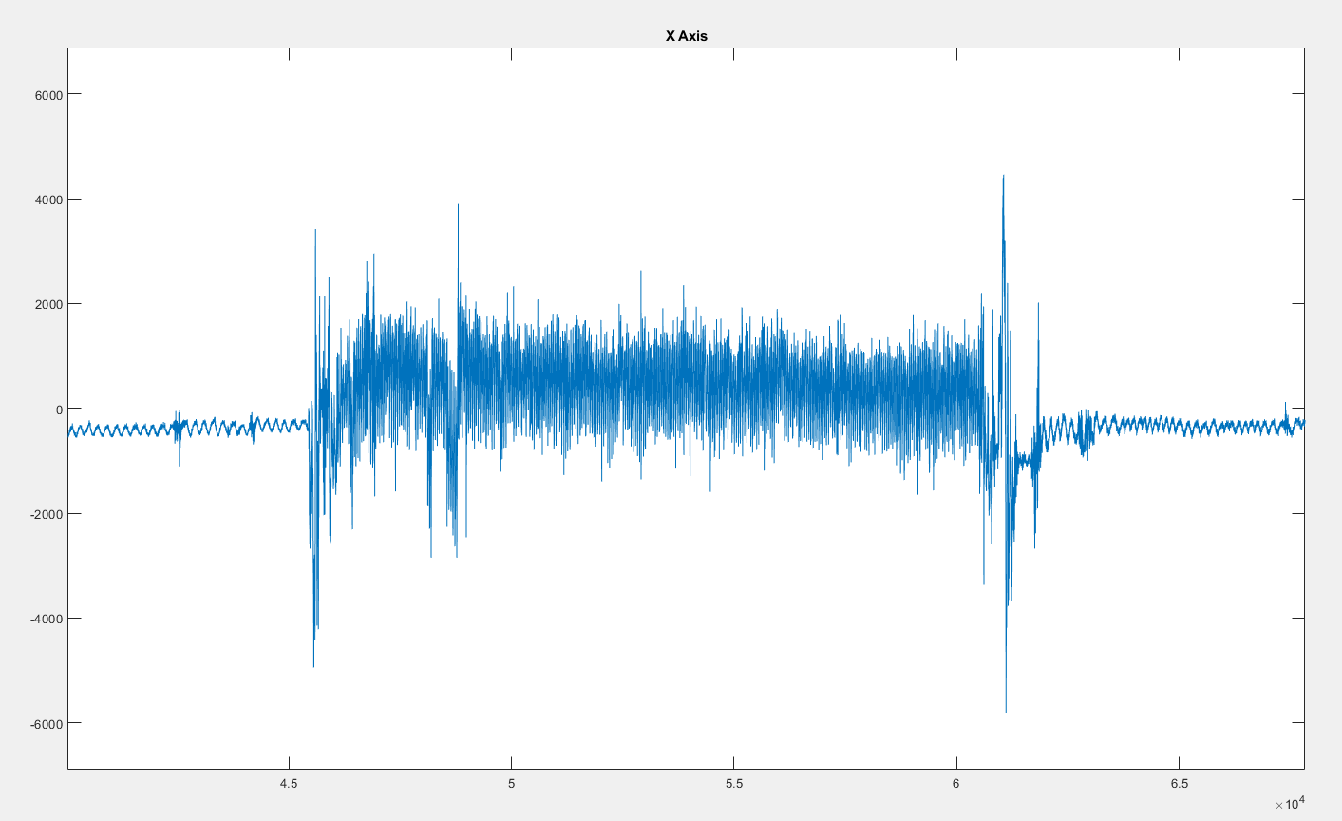
Accelerometer Data
Notes:
http://www.bem.fi/book/aa/fi/aa01.gif

Slide 35

Respiration Signal Derivation (Cysarz et al., 2008 )
Segmented process
Interpolate distances between R peaks
Maintain original signal as best as possible (intrep1)
Standardize signal
75th percentile of local maxima
Check for valid cycles
30th percentile of local maxima

Slide 36
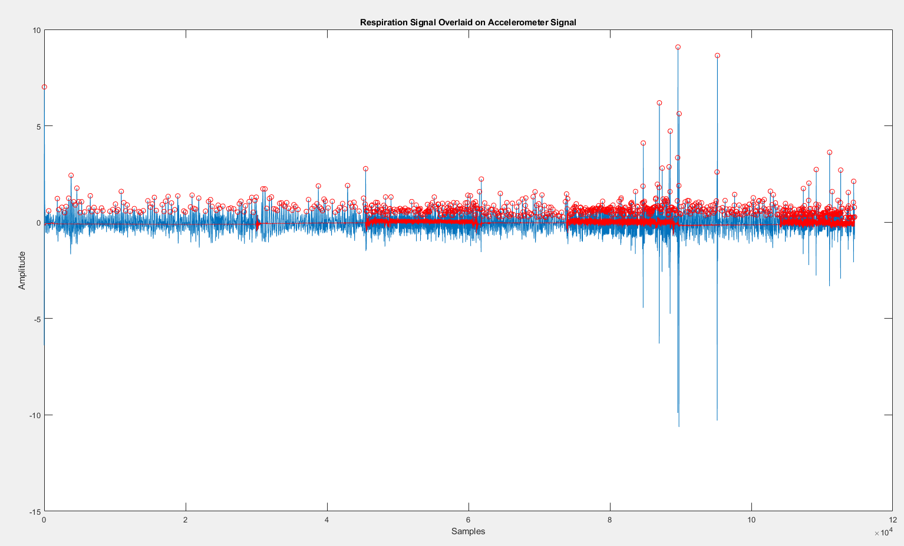
1.
2.
3.

Slide 37
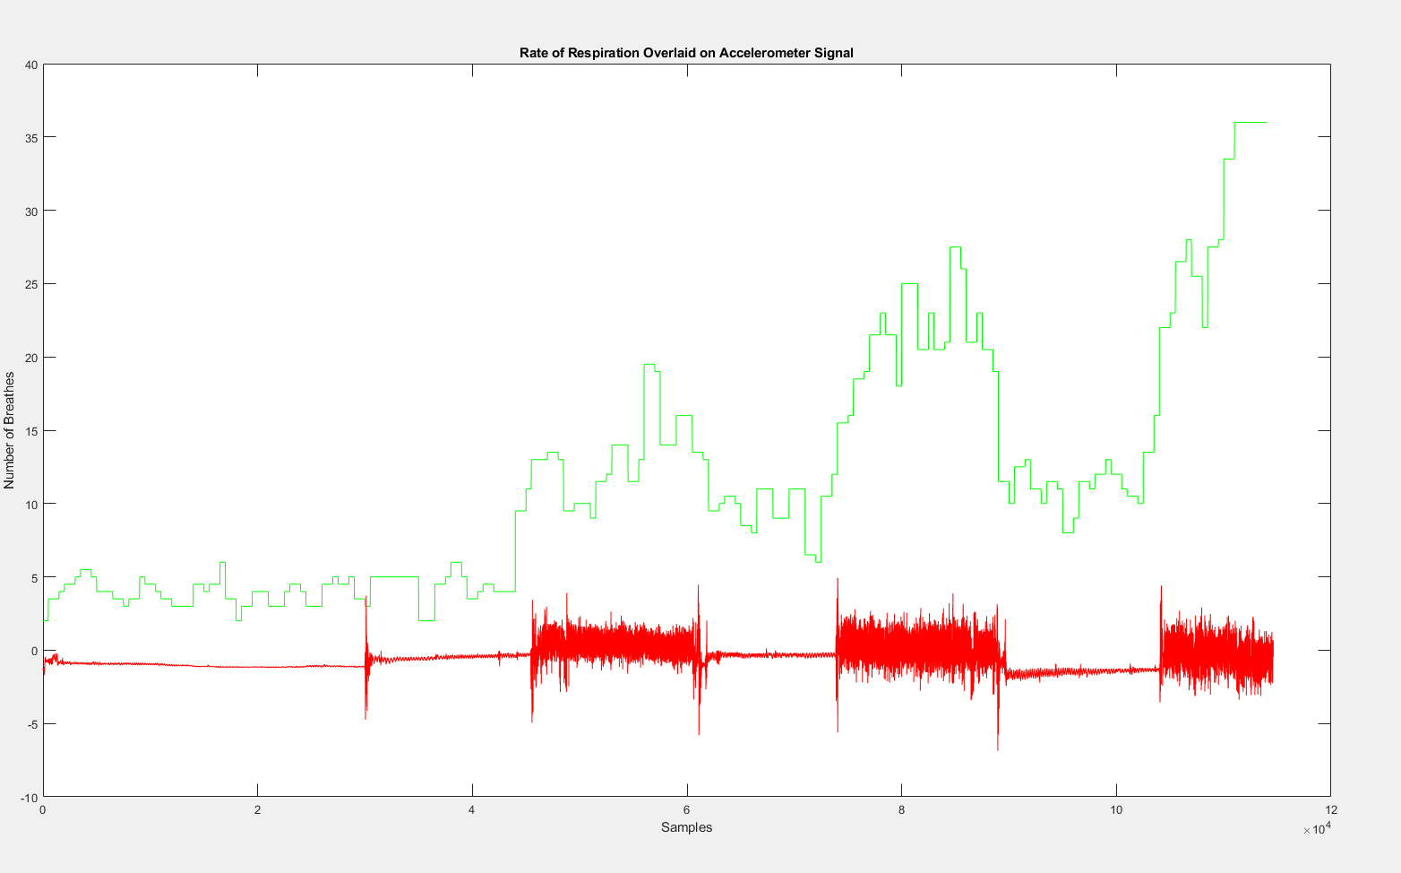

Slide 38
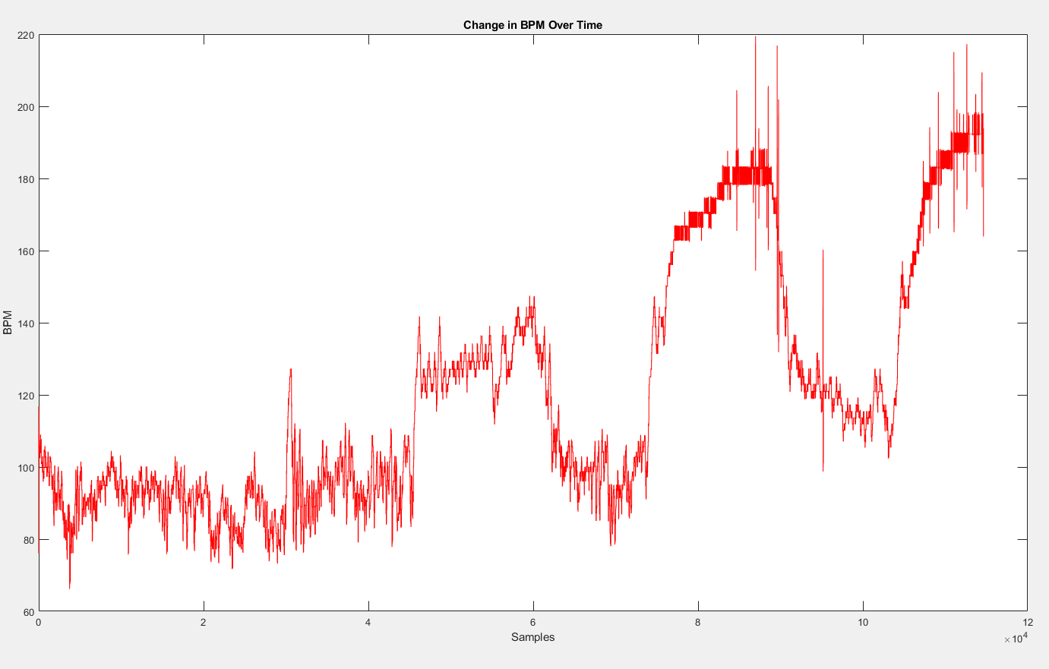
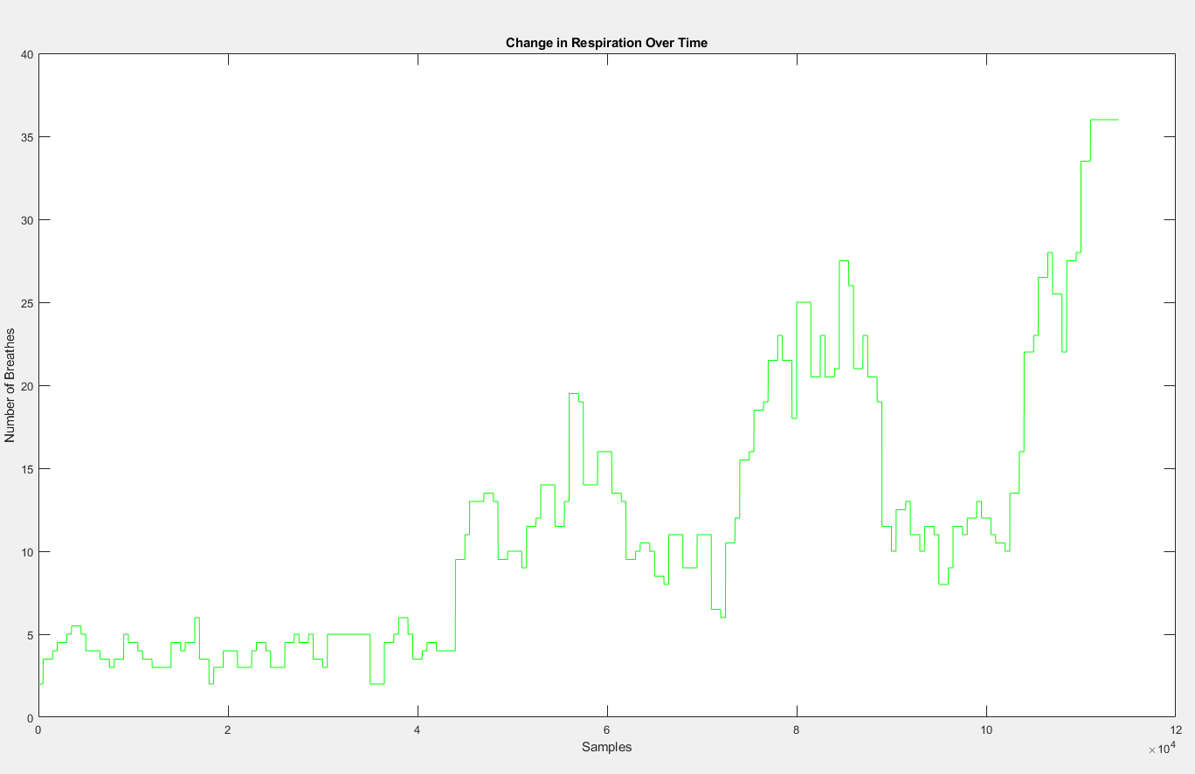

Slide 39
What’s next
Attempting to automate this entire process
This will be very difficult since every person’s heart is different
Weight, age, and fitness will affect their ECG tracing meaning different filters and peak parameters will have to be tested by hand

Slide 40
Works Cited
• Boyle, J., Bidargaddi, N., Sarela, A., & Karunanithi, M. (2009). Automatic Detection of Respiration Rate From Ambulatory Single-Lead ECG. IEEE Transactions on Information Technology in Biomedicine,13(6), 890-896. doi:10.1109/titb.2009.2031239
• Cysarz, D., Zerm, R., Bettermann, H., Frühwirth, M., Moser, M., & Kröz, M. (2008). Comparison of Respiratory Rates Derived from Heart Rate Variability, ECG Amplitude, and Nasal/Oral Airflow. Annals of Biomedical Engineering, 36(12), 2085–2094. doi: 10.1007/s10439-008-9580-2
• Documentation. (n.d.). Retrieved from https://www.mathworks.com/help/
• A Better Way To Learn. (n.d.). Retrieved from https://www.osmosis.org/prime-ecg-series?utm_source=youtube&utm_medium=video_description&utm_campaign=ecg_basics&utm_content=ecg_basics

